Slide 1
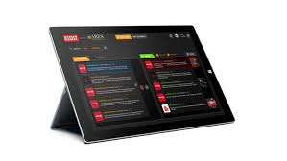

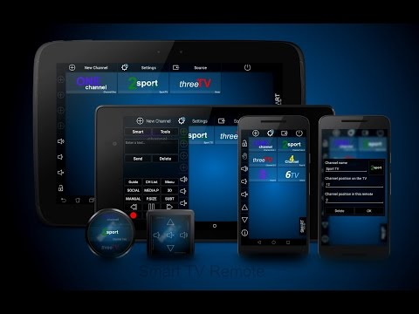
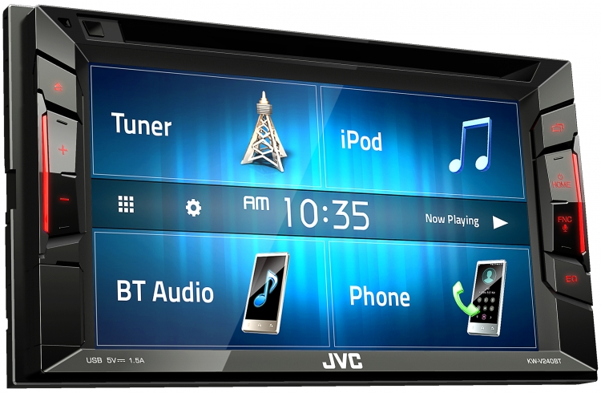

Investigating Multimedia products

Slide 2
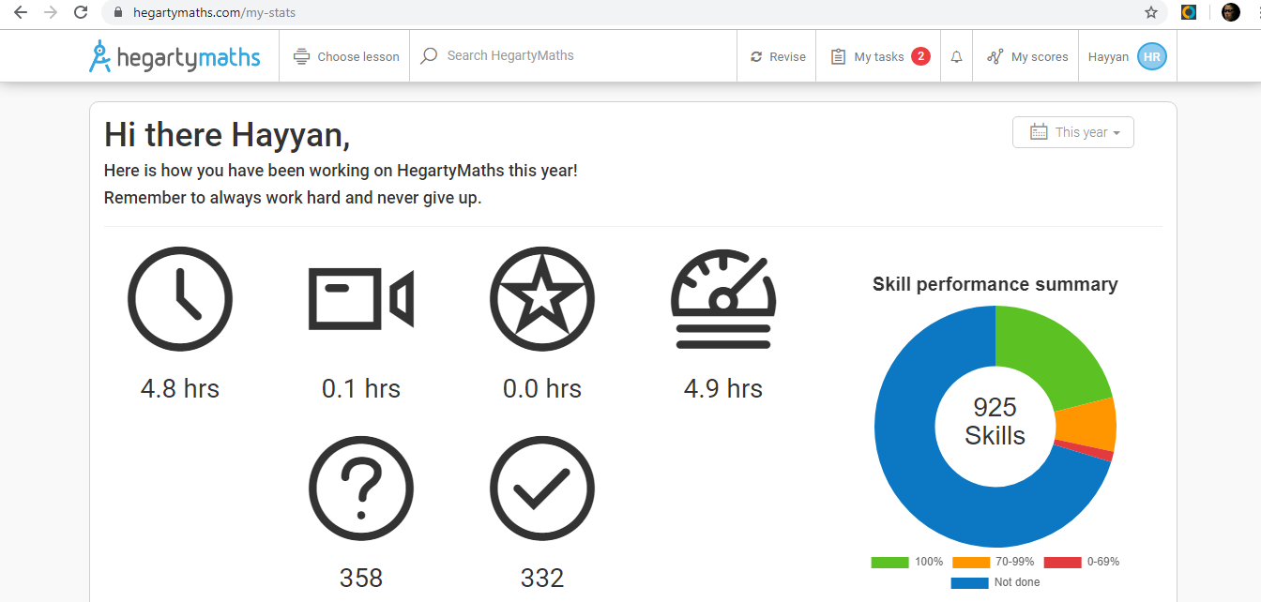
HegartyMaths
The little bell icon will take you to your notifications left by your Maths teacher.
When you click on ‘My tasks’, it shows you what current homework tasks you need to complete and how much time you have before it is due in. Hyperlink
The ‘My scores’ shows the scores you achieved for all of your tasks. It will show it in a list and if you click on one of the task it will give you an overview of what you got right and what you got wrong. Hyperlink
The ‘Choose lesson’ will bring a list of every task that is on HegartyMaths. The tasks will be in categories so you need to pick which category your task is in in order to do it. Drop down

Slide 3

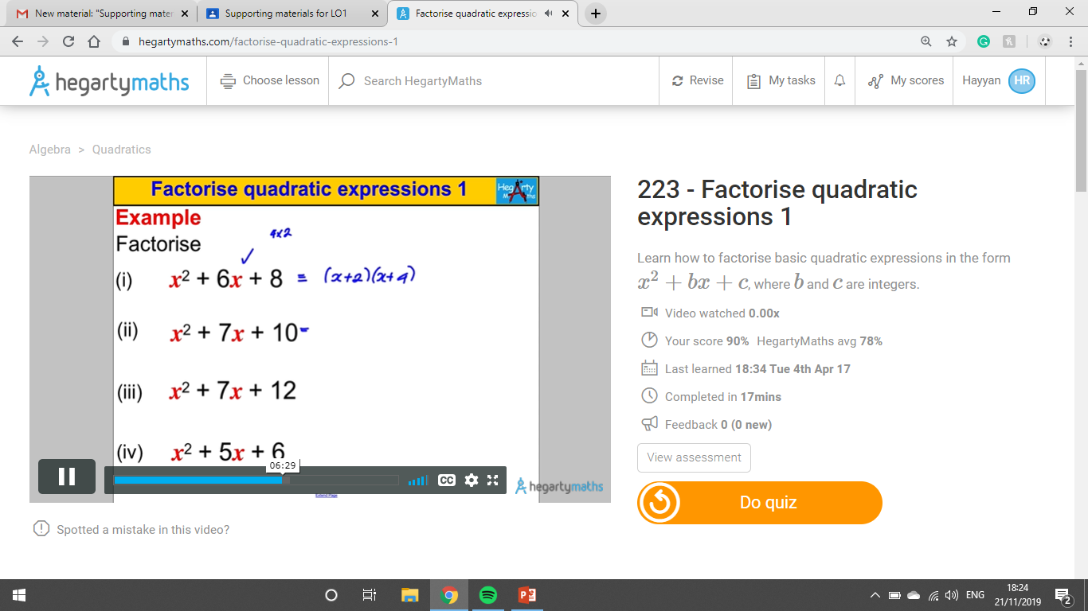
There is a video in every task so if you are struggling with something, you can watch the video to help you. You can pause it whenever you need to as well. Video
You can also adjust the volume to loud or quiet depending on how you want it. Sound

Slide 4
The purpose of Hegarty Maths is to help people with their homework tasks and Maths in general. It does this by using hyperlinks and videos so you can watch them if you are struggling with a task. It is also useful for teachers as they can set tasks for their students to do.
The target audience is people that are in education and for teachers. This is because students get homework and Hegarty Maths is a place where you can do homework tasks on. Teachers can set tasks for students to complete.
I use Hegarty Maths myself to do homework tasks. My Maths teacher sets topics that we are struggling on so we can get help and practice the topic.

Slide 5
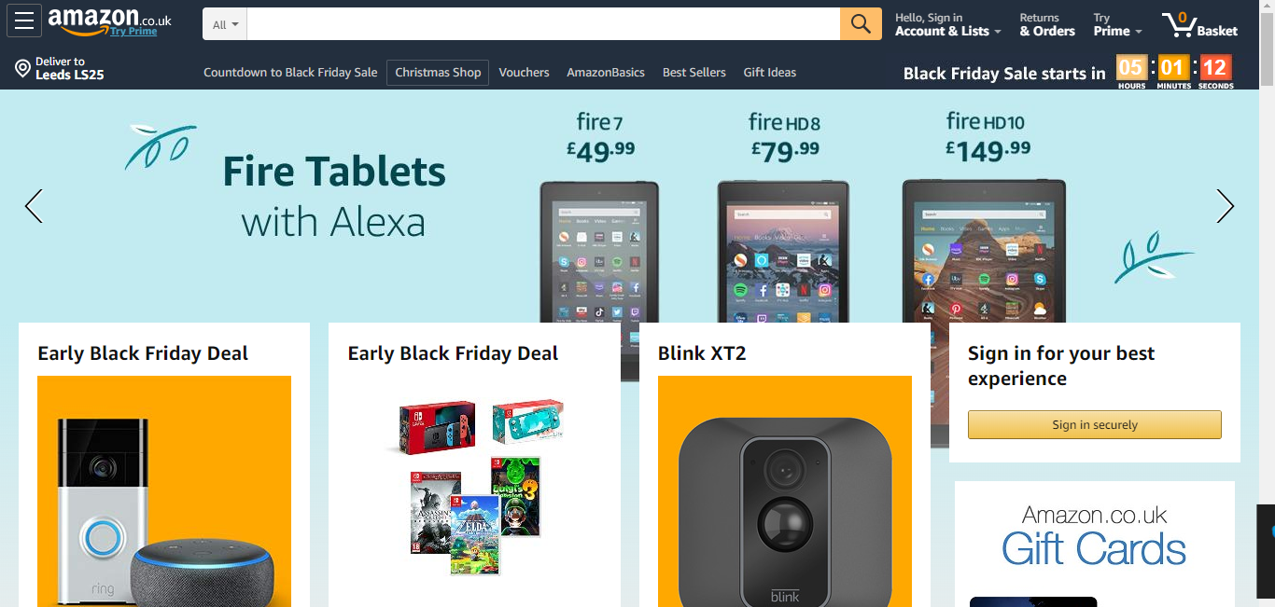
Amazon
When you click the Amazon logo, it will take you back to this homepage. Hotspot
This shows your account details and some wish lists for kids, men and women in a list. Drop down
When you hover the mouse over a link then a square will appear around it to inform you that you are looking at that option. Rollover. Hyperlink

Slide 6
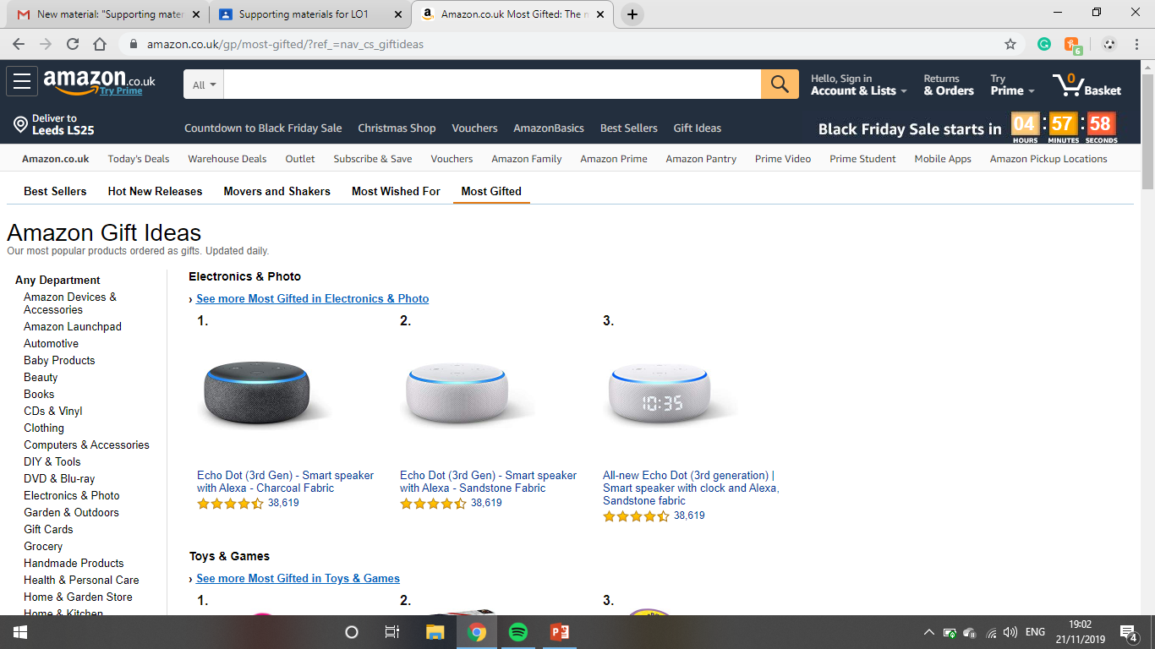
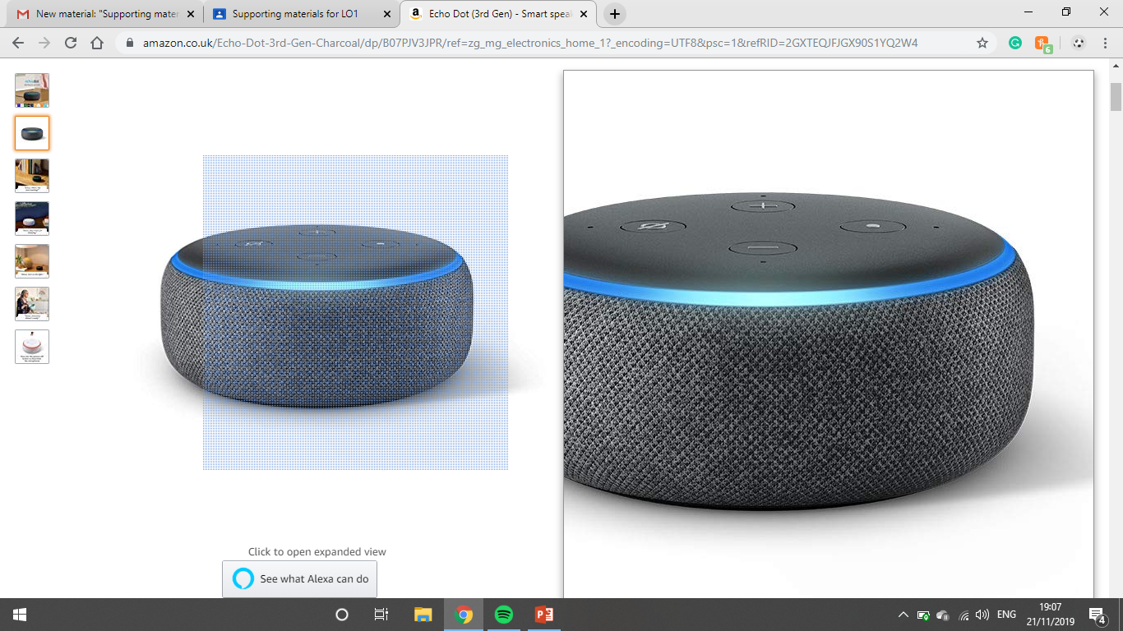
When you click on a product, you can zoom in and out of the product to see it in more detail. Hover the mouse over the product and you can see a zoomed in version of the product. This will allow you to see it in more detail. Zoom in and out features. Rollover
There is a drop down when you click on ‘Any Department’ and there will be lots of options where you can browse products. Dropdown

Slide 7
The purpose of Amazon is to sell products at the lowest possible price as it is a company.
The target audience is pretty much anyone as kids can browse toys for themselves, teenagers can look for headphones or watches and adults can look for toiletries and gifts such as watches. They also sell electronics which is suitable for every age.
I use Amazon to search for anything that me or my family wants to buy such as gifts, toys and headphones.

Slide 8
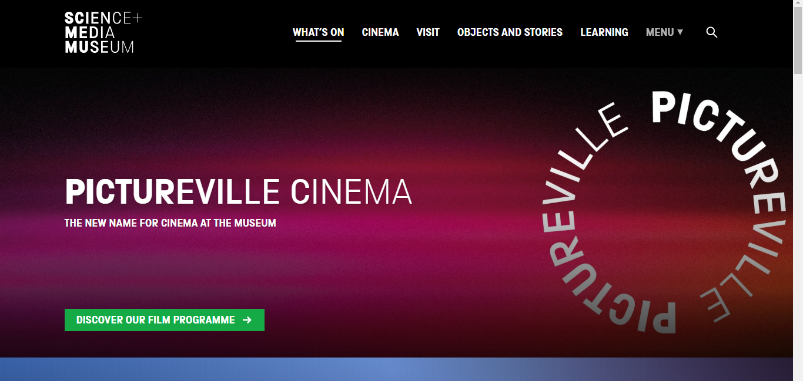
National Media Museum
If you want to go back to the homepage then you can click the logo. Hotspot
When you hover the mouse on one of the subheadings then a line appears underneath it to show you that you have selected the option. Rollover
When you first load up the website there is a animation as the words at the middle come together. Animation
If you want to learn more about the film programme then you can click the link to learn more. Hyperlink

Slide 9
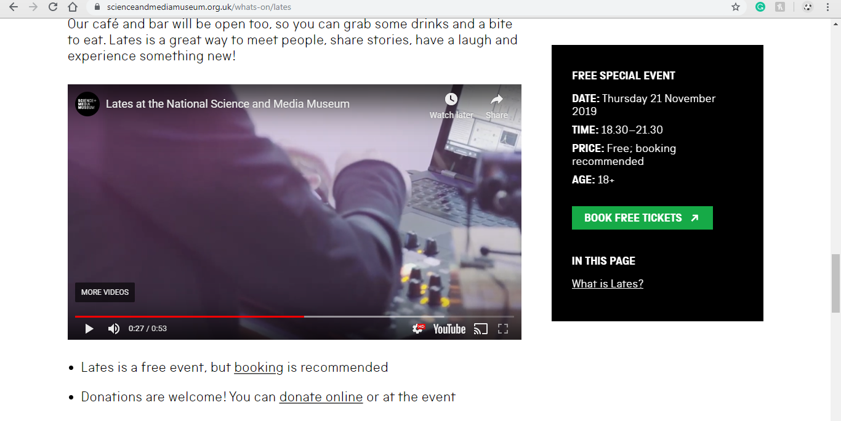
There is a video to watch to learn more information about the museum. It also has sound that you can adjust. Sound. Video

Slide 10
The purpose of the museum website is to give general information about the museum and has the option to book tickets to go to the museum and look at antiques.
The target audience is people over 6 years old as anyone can see the antiques at museums and see what objects there are. Adults and children can go to the museum as it can also provide education as there are artistic things in museums with scientific significance.

Slide 11
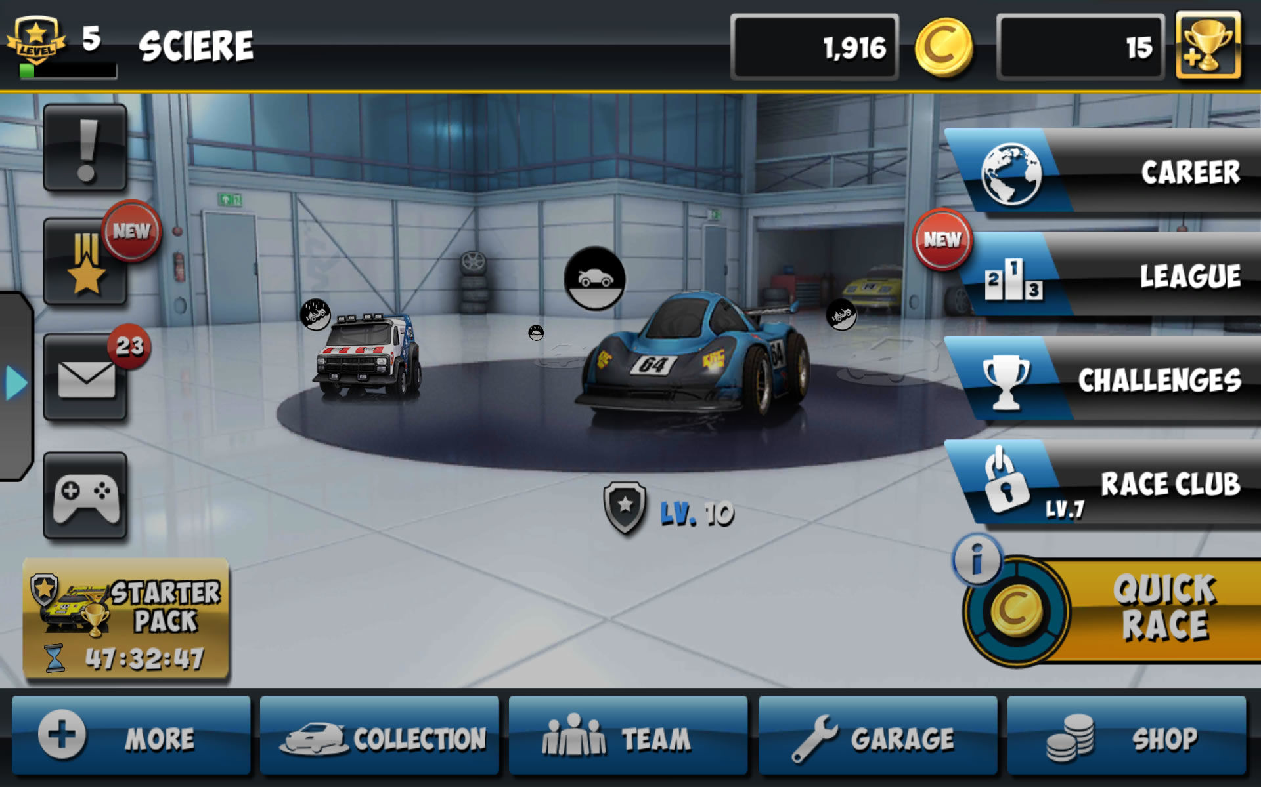
Mini Motor Racing WRT by MobyGames
Normally there is background sound which can be muted and little animations on the loading screens to engage the audience and keep them entertained for a short while.Videos. Sound
When you click ‘Career’ it will take you to choose from a range of races to try.
When you click ‘League’, it will give you a list of top racers across the globe/country
Drop down
If you click one of the options at the bottom it will take you to another page to view achievements and any in-game mail you have. Hyperlink
When you click on any of these options then it lights up showing that you have pressed that option. Rollover. Flash banner

Slide 12
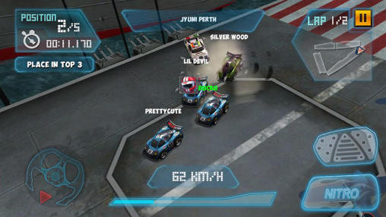
Clicking this button will bring a list of options you can do, such as changing settings, sensitivity and you can quit the current game event you are playing. Hyperlink
As you progress through the race, this 3D animation screen updates you on your current racing position. Animation

Slide 13
The purpose of Mini Motor Racing is to entertain people who like racing games. Also, this app is free which attracts the target audience as they don’t have to pay to actually play the game, however there are in-game purchases one can willingly buy to further attract the audience to continue playing as they offer exclusive offers and limited-edition cars to improve the user experience. The target audience is a young one (6-12 years) because it involves harmless racing with very mild violence (hitting of cars) and the nature of the design of the cars further suggest it is intended for youngsters as developers tend to make things much more violent for older people that like racing with high end cars and more action.

Slide 14
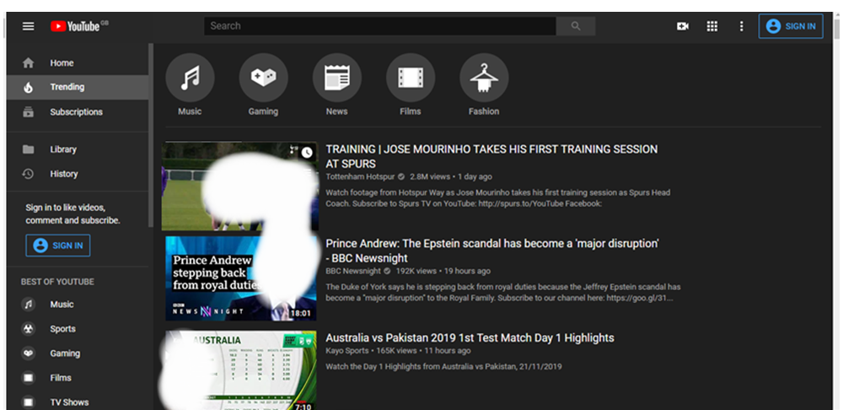
YouTube
If you click any of these options, then it will take you to a page with videos that are related to the topic. Hyperlink
This will take you to a dropdown of videos that you have watched previously and saved. Drop down
Hover your mouse over any video, and it shows you a few seconds of preview to give an insight to the topic of the video (called Inline playback). Flash banner

Slide 15
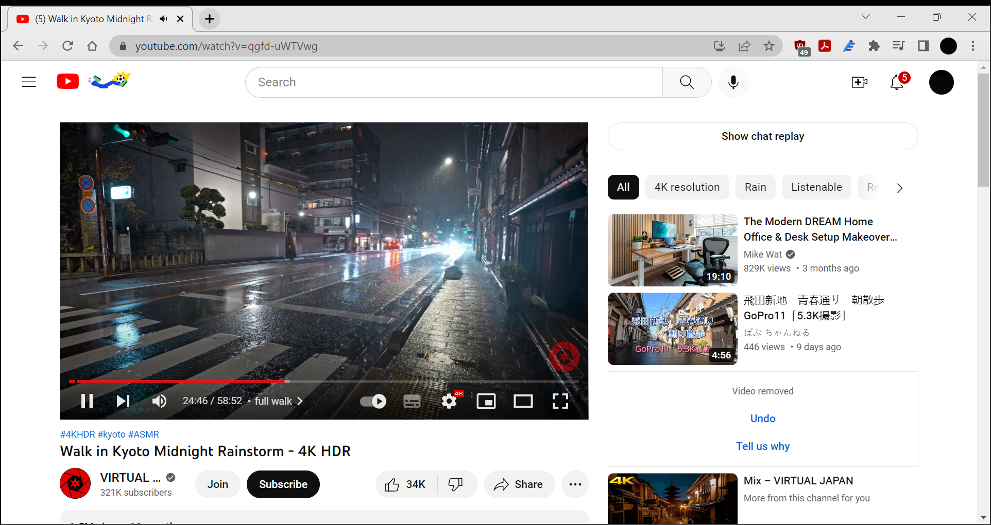
When you click the video it will take you to this so you can watch it. It has sound that you can adjust to your own preference. Video. Sound
Also, if you want to like the video or dislike it, then you can click one of the thumbs and it will turn blue, indicating that you have either liked it or disliked it. Rollover

Slide 16
The purpose of YouTube is to entertain people with videos of any topic and genre.
The target audience for YouTube is any age as for many young people and teenagers, YouTube is used to watch music videos, comedy shows, funny videos and gameplay. Adults use it for how to guides, recipes, hacks and more.
I use YouTube to watch lectures and people taking down scammers. I also use it to watch football highlights and any interviews about matches.

